Slide 1
Harnessing Cloud Synergy for Streamlined Healthcare and Life Sciences Ventures
Submitted in the partial fulfillment for the award of the degree of
BACHELOR OF ENGINEERING
IN
CSE - IBM (Hons.) Internet of Things
Submitted by:
Prabal Manhas
20BCS4513
Under the Supervision of:
Dr. U. Hariharan
(E11201)
Department of AIT-CSE
DISCOVER . LEARN . EMPOWER

Slide 2
Outline
Introduction to Project
Problem Formulation
Objectives of the work
Methodology used
Results and Outputs
Conclusion
Future Scope
References

Slide 3

Introduction to Project
Courtesy – freepik.org
In the midst of a digital revolution, the healthcare and life sciences industries are navigating a transformative paradigm shift. A surge in data generation, coupled with the imperative for personalized medicine and innovative research approaches, demands a strategic overhaul. In response to this dynamic landscape, cloud computing emerges as a linchpin, ushering in efficiency, scalability, and innovation.
Our project, titled "Harnessing Cloud Synergy for Streamlined Healthcare and Life Sciences Ventures," embarks on an exploration of the pivotal role played by cloud computing platforms, including Amazon Web Services (AWS), Microsoft Azure, and Google Cloud Platform (GCP). These platforms have become indispensable allies, offering tools to leverage the potential of data-driven insights and optimize operational processes.

Slide 4
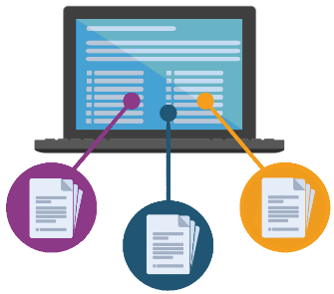
Introduction to Project
courtesy : pngwing.com
This journey transcends mere infrastructure migration; it demands a holistic approach reshaping how healthcare data is collected, processed, and analyzed. The promise is not only operational efficiency but profound improvements in patient outcomes and advancements in medical research.
This endeavor is not merely an examination but a hands-on demonstration of the capabilities, employing Python scripts on GCP for data acquisition, transformation, and decision-making. The results showcase not just successful data handling but a tangible pathway for healthcare innovation.

Slide 5
Introduction to Project
In the next slides, we will walk you through our objectives, methodology, and results analysis unveiling the transformative power that cloud technologies bring to the forefront of healthcare and life sciences.

Slide 6

Problem Formulation
In the digital age, healthcare and life sciences face a multifaceted challenge. The unprecedented influx of data, coupled with the imperative for personalized medicine and innovative research, necessitates a paradigm shift. Traditional approaches to data management and analysis are proving inadequate in the face of this deluge.
courtesy : freepik.org

Slide 7

Problem Formulation – Key Challenges
courtesy : flaticon.com
Data Overload: The sheer volume of healthcare data is overwhelming, creating bottlenecks in processing and analysis.
Lack of Interoperability: Siloed healthcare systems impede seamless collaboration and information exchange among professionals.
Security Concerns: Sensitive patient data requires robust security measures to protect against breaches and unauthorized access.
Operational Inefficiencies: Outdated infrastructure hampers operational efficiency, hindering the swift deployment of innovative healthcare solutions.
Decision-Making Complexity: Healthcare professionals are faced with the daunting task of extracting meaningful insights from vast datasets, often in real-time scenarios.

Slide 8

Problem Formulation – Our Approach
Cloud Synergy: We propose a strategic shift towards cloud computing to address these multifaceted challenges, fostering a unified, scalable, and secure ecosystem for healthcare and life sciences.
Platform Evaluation: Our research meticulously examines three major cloud platforms – AWS, Azure, and GCP to identify the most suitable solution for empowering innovation and efficiency in healthcare ventures.
Data-Driven Decision Making: Leveraging Python scripts on GCP, we enhance the decision-making process, ensuring a dynamic, contextually relevant response to user queries, leading to more informed and efficient healthcare practices.
Holistic Data Security: Our commitment to data security includes private Google Cloud Storage, encrypted data transmission, data anonymization, and Role-Based Access Control (RBAC), ensuring a robust shield for sensitive healthcare information.

Slide 9

Objectives of the Work
Data Acquisition and Import
Data Transformation with Power BI Advanced Query Editor
Decision Making Process
Microsoft Power BI Heatlh Dashboard Creation
Visualization Exploration
Embedding the Health Dashboard into HTML Webpage
Designing our HTML Webpage
Hosting the Website over GitHub Pages
Python Scripts for Enhanced Decision-Making Functionality
Google Cloud Data-Driven Insights
Secure Data Handling only
courtesy : flaticon.com

Slide 10
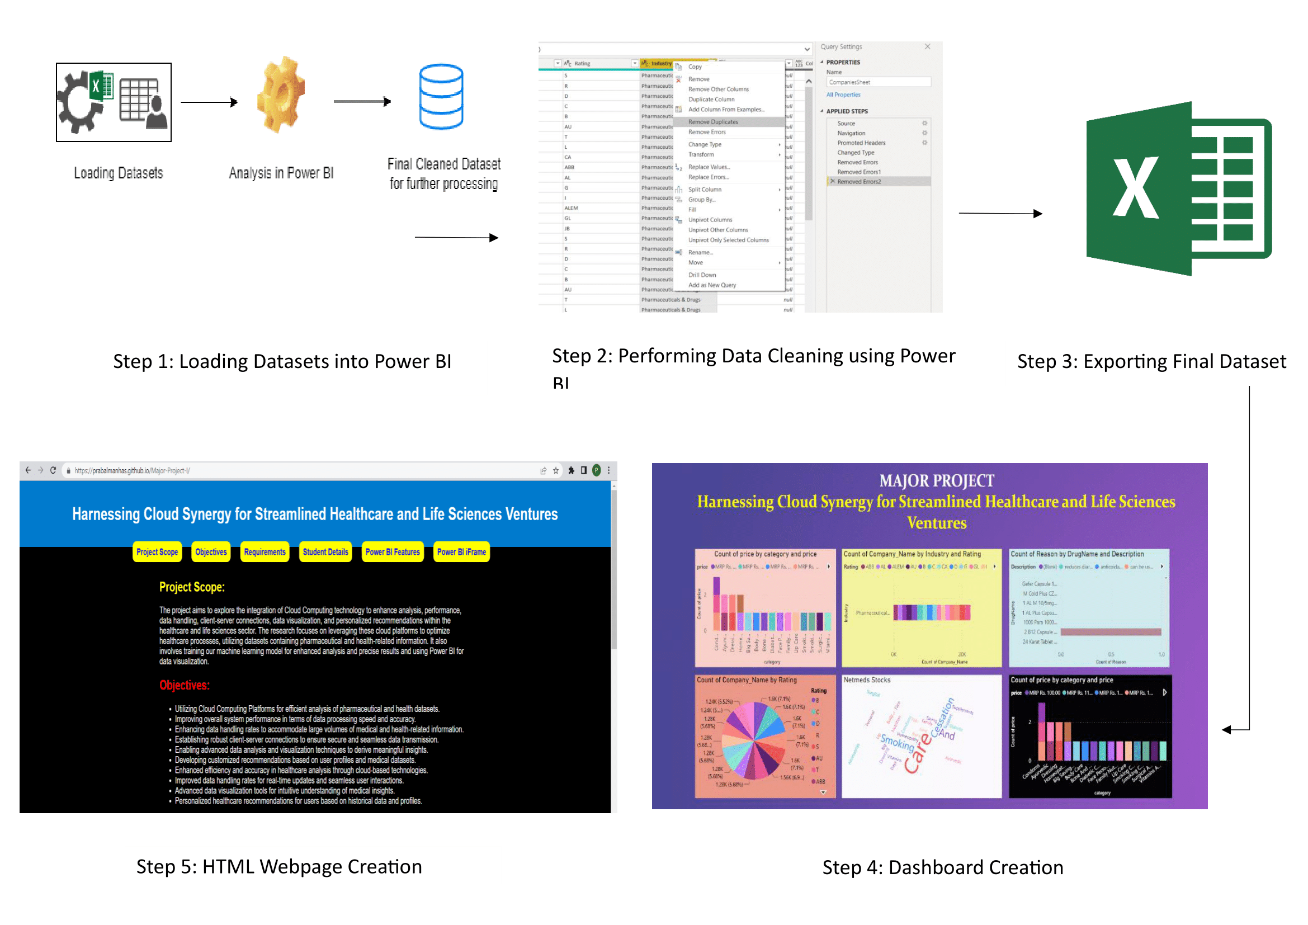
Methodology used

Slide 11
Methodology used
Data Acquisition: Retrieve datasets (Companies.xlsx and Medicines.xlsx) from secure Google Cloud Storage using GCP storage client.
Interactive User Interface: Develop a user-friendly interface allowing dynamic inputs for queries related to medicines, diseases, and pharmaceutical companies.
Dynamic Decision Paths: Employ Python script hosted on GCP to dynamically navigate through decision paths based on user inputs.
Data Processing and Analysis: Utilize Python scripts for data processing and analysis, showcasing capabilities such as average ratings and prescription analytics.
Data Security Measures: Ensure data security through private Google Cloud Storage, encrypted data transmission, data anonymization, and Role-Based Access Control (RBAC).

Slide 12
Methodology used
VI. Assessment of Performance and Scalability: Evaluate the performance and scalability of AWS, Azure, and GCP in handling substantial computational and storage requirements.
VII. Ensuring Safe Data Handling: Implement measures, including private Google Cloud Buckets and secure data transmission, to fortify data security.
VIII. Cloud Solutions Integration: Explore and integrate cloud solutions for advanced healthcare applications on AWS, Azure, and GCP.
IX. Results Integration: Integrate results into a Power BI dashboard for visualization and analysis.
X. Python Scripts for Decision-Making: Implement enhanced decision-making functionality using Python scripts on GCP.
XI. Data-Driven Insights: Deploy GCP Virtual Machine Instances for data-driven insights, including medicine sales, ratings, drug analysis, and prescription categorization.

Slide 13

Results and Outputs
Our journey through cloud-based healthcare analysis has yielded tangible and impactful results. The integration of Python scripts on Google Cloud Platform (GCP) has fortified our decision-making process, ensuring efficiency and accuracy.
Explore with us the valuable data-driven insights, including medicine sales, ratings, drug analysis, and prescription categorization, hosted on GCP Virtual Machine Instances. Witness the successful embedding of Power BI in a custom HTML webpage, enhancing data visualization and facilitating user-friendly exploration for healthcare professionals and researchers alike.
courtesy : flaticon.com

Slide 14
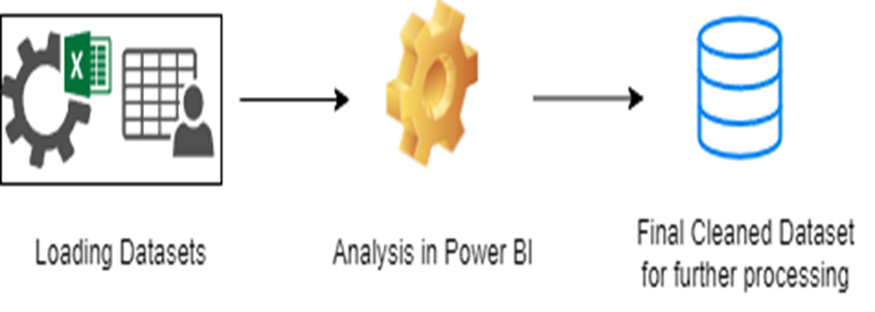
Results and Outputs
Data Import and Cleansing : In the initial step, healthcare datasets, encompassing medicines, companies, and ratings, were imported into Power BI. These raw datasets often contain inconsistencies, missing values, and inaccuracies. The data cleansing process aimed to rectify these issues. The result was successful data import and transformation, ensuring data quality for subsequent analysis.
Fig. 1. Data Importing and Cleaning Process

Slide 15
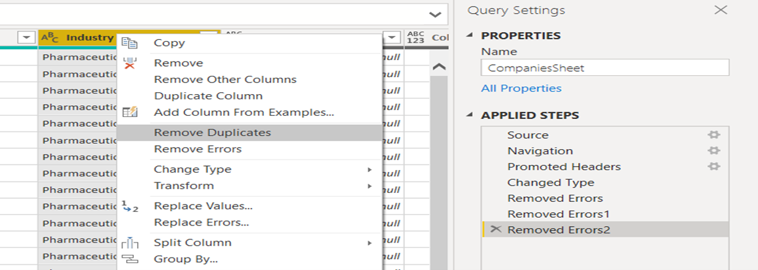
Results and Outputs
Data Transformation with Power BI Advanced Query Editor - Data transformation plays a pivotal role in data analysis. Using the advanced query editor, the dataset underwent necessary transformations, which included standardizing categories and addressing missing values. This transformed data is structured and optimized for analysis, forming a solid foundation for further insights.
Fig. 2. Data Cleaning with Microsoft Power BI

Slide 16
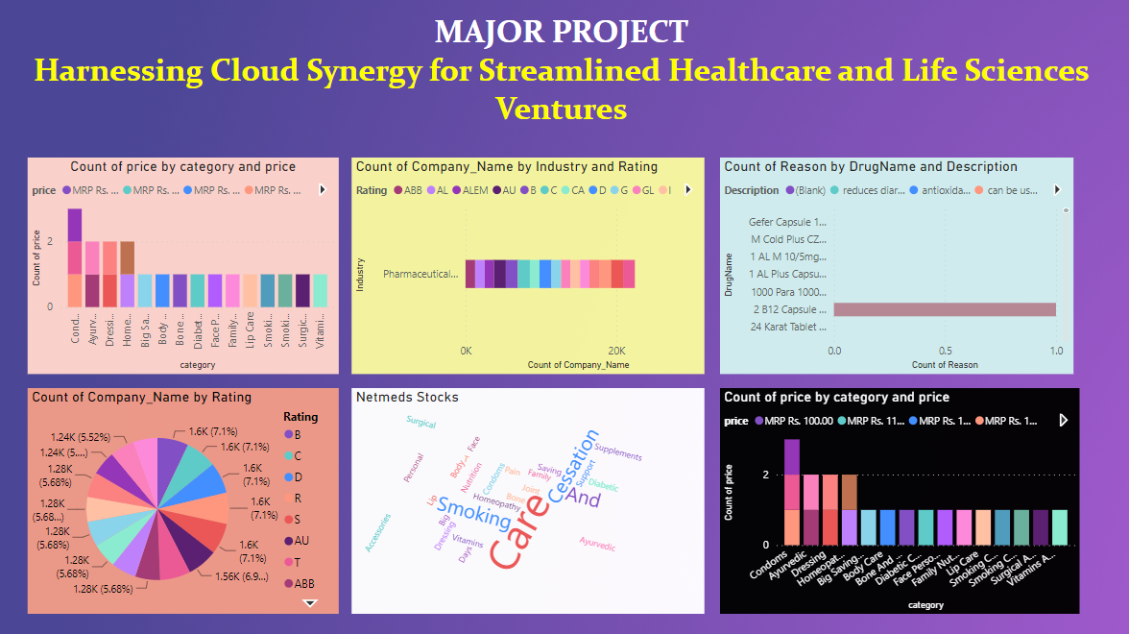
Results and Outputs
Power BI Health Dashboard Creation - Creating a comprehensive dashboard is a fundamental step in the methodology. Power BI, a powerful data visualization tool, was used for this purpose. The dashboard brings together various visualizations and key insights, making healthcare data accessible and user-friendly for professionals and researchers.
Fig. 3. Health Dashboard

Slide 17
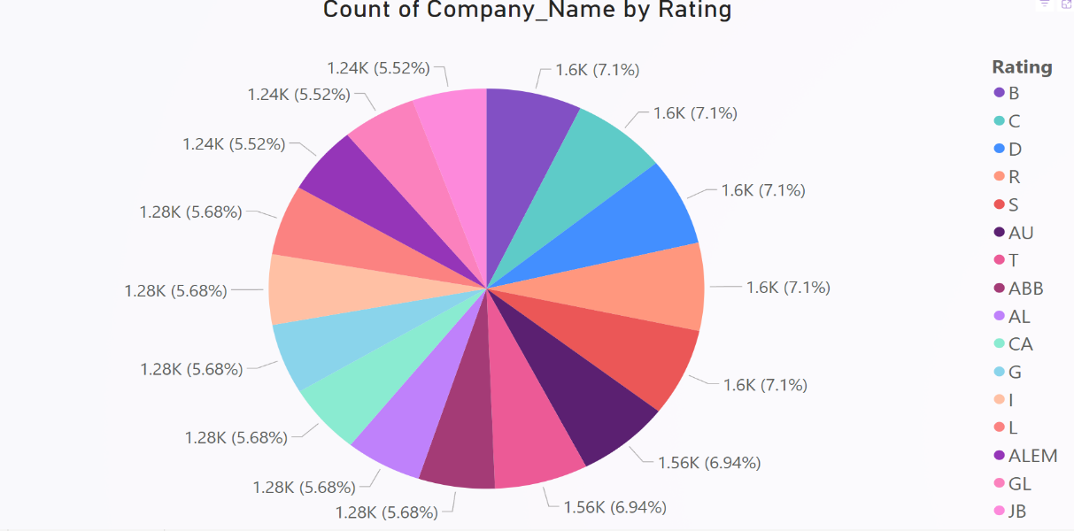
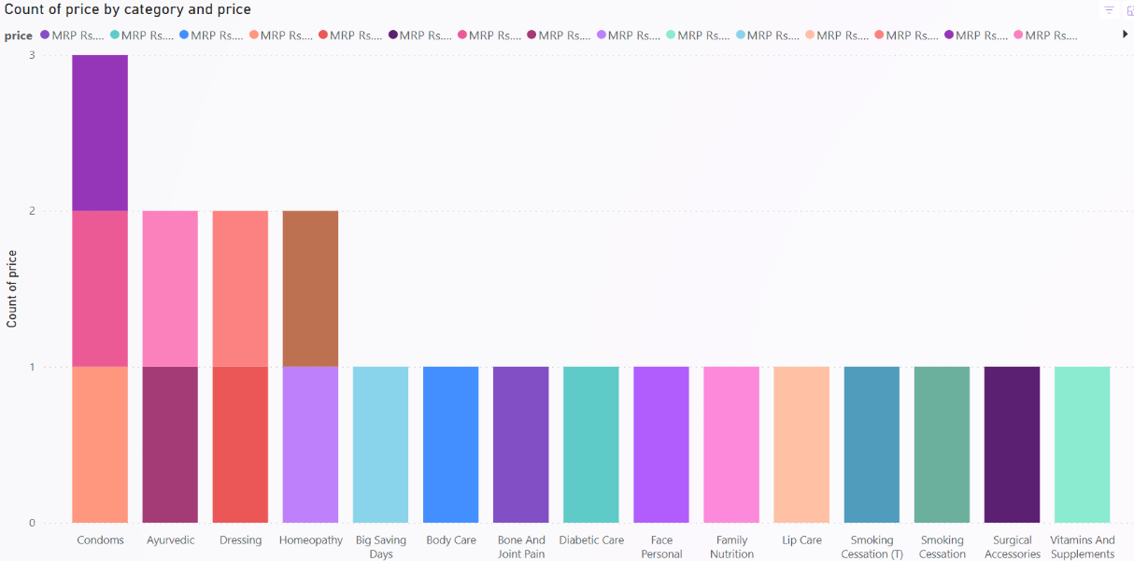
Results and Outputs
Visualization on Power BI - The theory behind data visualization guided the selection of visualization types. Visualization choices included word clouds, bar charts, scatter plots, and other forms. These visualizations offered valuable insights into various aspects, such as company counts, medicine trends, and prescription analytics, simplifying complex data for interpretation.
Fig. 4. Power BI Visualization

Slide 18
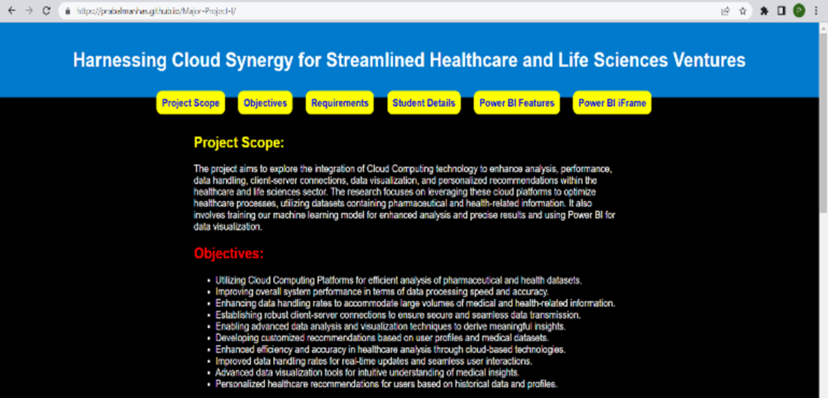
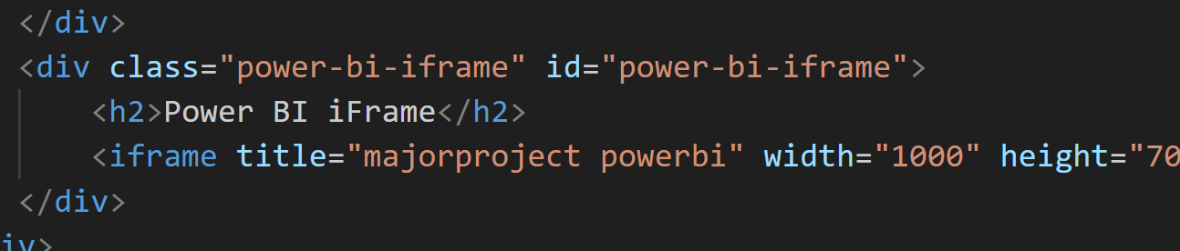
Results and Outputs
Designing our HTML Webpage - A custom HTML webpage was designed to ensure accessibility to the project's findings. The webpage design aligns with user experience and accessibility principles, creating a user-friendly platform for accessing healthcare insights.
Fig. 5. Designing the Webpage and Embedding the Dashboard using HTML Tags

Slide 19
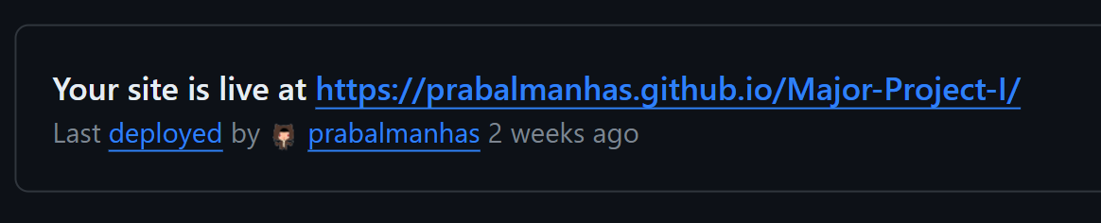
Results and Outputs
Hosting the Website over GitHub Pages - Hosting the webpage on GitHub Pages contributes to open access and collaboration. This approach adheres to the principles of open access, making the project's findings available to a wider audience.
Fig. 6. Deploying Website using GitHub Pages for Public Access

Slide 20
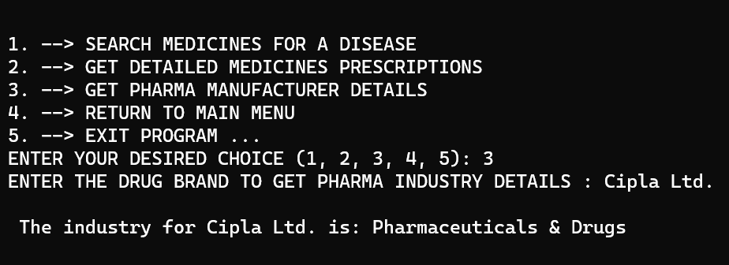
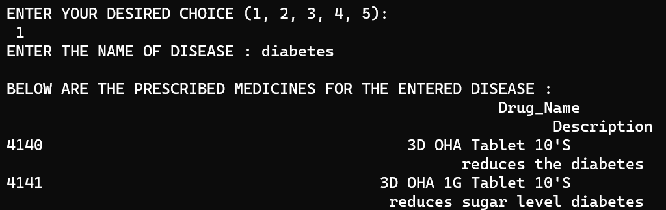
Results and Outputs
Python Scripts for Enhanced Decision-Making Functionality - The implementation of enhanced decision-making functionality is made using the Google Cloud Platform (GCP). By employing Python scripts and leveraging GCP services, the decision-making process is now more robust and efficient. The datasets stored in Google Cloud, will be fetched automatically without the need to download and save on local PC. This ensures high accuracy and ease of access.
Fig. 7. Enhanced Decision Making using Python Scripts

Slide 21
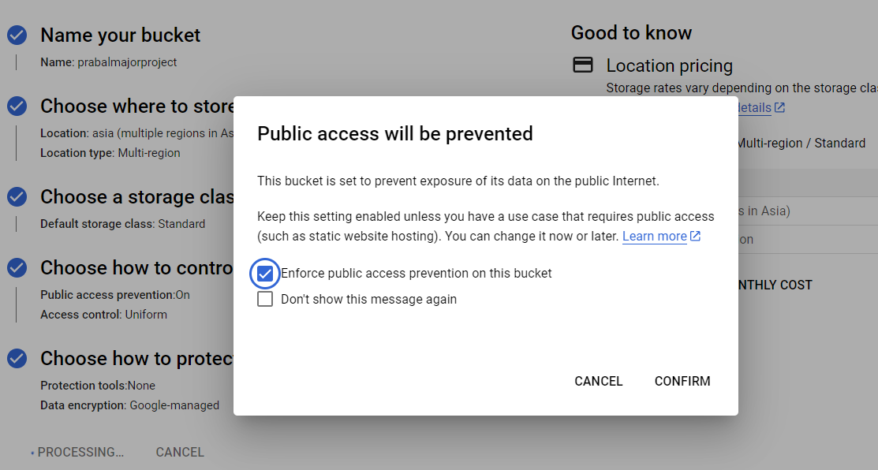
Results and Outputs
Secure Data Handling - Ensuring the security of healthcare data is paramount. The integration of secure data handling measures in the project involves stringent protocols during the data retrieval process.
Encrypted channels, such as HTTPS, are utilized to safeguard against potential data interception, ensuring the integrity and confidentiality of the information being transferred.
Fig. 8. Secure Data Handling

Slide 22
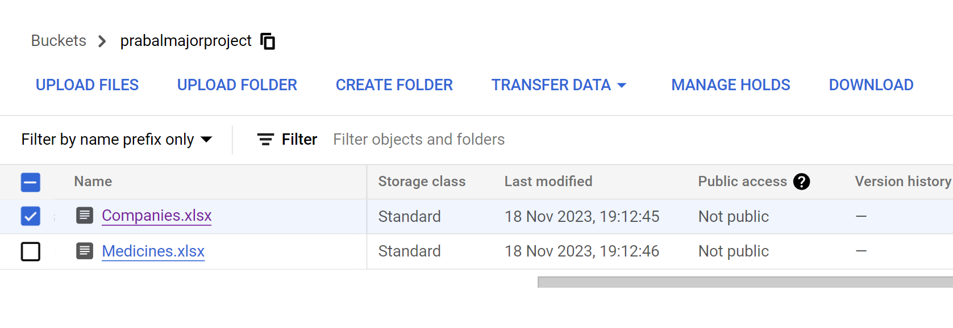
Results and Outputs
Data Protection through Private Google Cloud Buckets - To fortify real data protection, the project implemented a strategy of uploading datasets onto private Google Cloud Buckets. This ensures that sensitive data remains shielded and is used exclusively for computational purposes without the need to expose its contents to end-users.
The utilization of private buckets adds an extra layer of security, allowing for robust computing while maintaining the confidentiality of the healthcare datasets.
Fig. 9. Google Cloud Private Buckets for Healthcare Datasets

Slide 23

Conclusion
courtesy : flaticon.com
Our project, navigating data import, transformation, and visualization alongside custom HTML webpage design, GitHub Pages hosting, and Power BI integration, has crafted a user-friendly healthcare data exploration platform. The successful integration of Power BI into the webpage enhances data visualization and supports data-driven decisions in healthcare. Insights, such as medicine sales, ratings, and prescription analytics, contribute significantly to healthcare services and research.
This project underscores the growing role of cloud technologies in healthcare, providing efficient analysis tools and paving the way for innovation. The addition of Python scripts on GCP enhances decision-making functionality, automating dataset retrieval for accuracy. Data-driven insights on GCP instances offer valuable analytics, prioritizing security through encrypted channels and private Google Cloud Buckets. The project aligns with evolving cloud technologies, fostering innovation in healthcare and life sciences.

Slide 24

Future Scope
courtesy : flaticon.com
The future scope of this project extends to the development of dedicated mobile applications for both Android and iOS platforms. These applications will provide users with seamless and convenient access to healthcare data and insights, ensuring that vital information is at their fingertips whenever needed.
The mobile apps will enhance user engagement and further promote data-driven decision-making in healthcare. Additionally, the project's continuous integration with evolving cloud technologies promises to unlock new avenues for innovation, ultimately leading to more efficient healthcare analysis, enhanced medical research, and improved healthcare services

Slide 25
References
[1] IJRASET Publication. "Big Data Analytics in Healthcare: A Review of Challenges, Methods, and Tools" (2022). International Journal of Research in Advanced Science, Engineering and Technology.
https://irojournals.com/itdw/article/view/1/1/2
[2] J. International Journal of Advanced Research in Science, Engineering and Technology. "A Comprehensive Study on Cloud Computing in Healthcare: Applications, Challenges, and Future Directions"(2023).
https://www.researchgate.net/publication/309088652_Cloud_Computing_and_Healthcare_Services](https://www.researchgate.net/publication/309088652_Cloud_Computing_and_Healthcare_Services
[3] Journal of Data Science. "Leveraging Power BI for Data-Driven Healthcare: A Practical Guide" (2023).
https://dl.acm.org/doi/abs/10.4018/IJSI.293267
[4] Journal of Medical Internet Research. "The Impact of Cloud Computing on Healthcare: A Systematic Review" (2022).
https://www.jmir.org/2011/3/e67/
[5] Journal of Cloud Computing. "Exploring the Potential of Google Cloud Platform for Healthcare: A Case Study" (2022). https://pubmed.ncbi.nlm.nih.gov/37811595/
[6] Microsoft Health. "Power BI for Healthcare: A Comprehensive Guide to Data Visualization and Analysis" (2023).
https://powerbi.microsoft.com/en-us/industry/healthcare

Slide 26
References
[7] JMIR Publications. "Cloud Computing in Healthcare: A Review of Recent Literature" (2023).
https://www.irjmets.com/uploadedfiles/paper/volume2/issue_8_august_2020/3036/1628083115.pdf
[8] O'Reilly Media. "Google Cloud AI in Healthcare: A Practical Guide" (2022).
https://www.oreilly.com/library/view/practical-ai-on/9781492075806
[9] Healthcare IT News. "Power BI for Healthcare: Best Practices for Data-Driven Decision Making" (2023).
https://www.softwebsolutions.com/resources/power-bi-dashboard-for-healthcare-industry.html
[10] Forbes Technology Council. "Cloud Computing in Healthcare: A Comprehensive Overview" (2023).
https://www.forbes.com/sites/forbestechcouncil/2022/05/10/how-technology-puts-the-care-in-healthcare-the-role-of-the-cloud-during-the-pandemic
[11] Ahmed et al. "A scoping review of cloud computing in healthcare" (2023).
https://link.springer.com/book/10.1007/978-1-4614-5629-2
[13] Sharma et al. "Implementation of cloud computing in healthcare" (2023). https://www.researchgate.net/publication/353165013_CLOUD_COMPUTING_IN_HEALTHCARE
[14] Singh et al. "Big data analytics in healthcare using Google Cloud" (2023). https://www.emerald.com/insight/](https://www.emerald.com/insight
[15] Patil et al. "Big data in healthcare: management, analysis and future prospects" (2023).
https://onlinelibrary.wiley.com/doi/abs/10.1002/9781119792550.ch14

